Slide 1
JAVA Mini Project
Coffee machine program

Slide 2
Objective
The objective of the Coffee Machine program is to create a simulation of a coffee vending machine that:
Allows users to select from a menu of drinks.
Checks if there are sufficient resources to prepare the chosen drink.
Processes monetary transactions, including accepting payments and providing change.
Updates and reports on the state of resources and financial profit.
Enables maintenance by allowing the machine to be turned off.

Slide 3
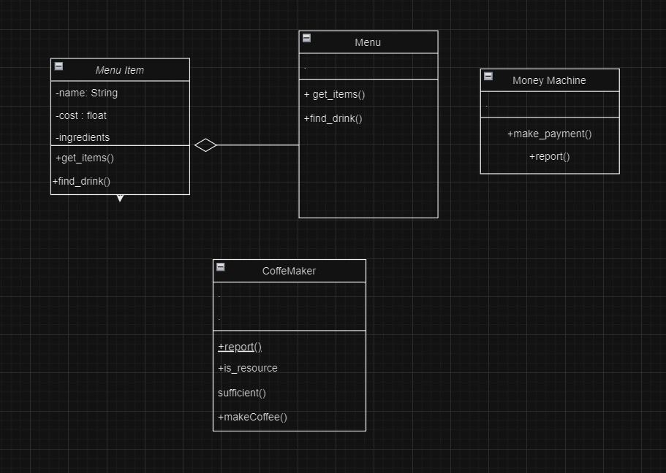
methodology
The Coffee Machine program is designed and implemented with the following methodology:
Classes Mention in Program:-
MenuItem
Menu
Money Machine
Coffemaker

Slide 4
+ Implement Interaction Logic: -
User Input Handling: Continuously prompt the user for input. Based on the input, interact with the Menu, CoffeeMaker, and MoneyMachine classes to perform the appropriate actions.
Resource and Transaction Management: Check if resources are sufficient for the selected drink. If so, handle the payment and update the machine's resources and profit.
Error Handling: Provide user feedback in cases of insufficient resources or inadequate payment, and manage user commands like "report" and "off".

Slide 5
Concepts Used (oops)
a). Encapsulation
Definition: Encapsulation involves bundling data and methods that operate on the data into a single unit (class) and restricting direct access to some of the object’s components.
Application: In Java, each class (MenuItem, Menu, CoffeeMaker, MoneyMachine) encapsulates its own data (attributes) and methods. For instance:
The MenuItem class encapsulates the details of a drink (name, cost, ingredients).
The CoffeeMaker class encapsulates resource management methods (report(), is_resource_sufficient(), make_coffee()).

Slide 6
b.) Abstraction
Definition: Abstraction involves hiding the complex implementation details and showing only the necessary features of an object.
Application: In Java, abstraction is achieved through classes and methods. Users interact with simplified methods like make_coffee() or report() without needing to know how resources are managed or how payments are processed:
MenuItem provides a simplified view of a drink.
CoffeeMaker abstracts the details of resource management.
c.) Polymorphism
Definition: Polymorphism allows objects of different classes to be treated as objects of a common superclass. It enables one interface to be used for a general class of actions.
Application: In Java, polymorphism allows methods to operate on objects of different types, such as different MenuItem objects. For example:
Methods in CoffeeMaker like is_resource_sufficient() and make_coffee() can handle various MenuItem instances interchangeably.

Slide 7
DEMONSTRATION:-
CODE:- https://github.com/PrAyAg9/CoffeeMachine
SUBMITTED BY:-
Uttam Kumar - 22BCE10946
Prayag Thakur - 22BCE10958

